Slide 1
Weekly Update 6
Team Dragonflies

Slide 2
Re-cap
Hotel price prediction
based on Personalize Expedia Hotel Searches - ICDM 2013
Feedback from prof.:
Using correlation to check individual feature
Normalize data for ridge
Keep explore the features selection
Do evaluation on both training and test datasets (in-sample performance vs out-sample performance)
Don’t use test data to do feature selection; start from simple (correlation between individual feature and target), bin x data and bin y data. Lasso or random forest is checking the combination of the features and target. 0 to 1 for lasso (parameter setting)

Slide 3
Content
Evaluation pipeline setup
Features selection analysis
Baseline and evaluation
Next step

Slide 4

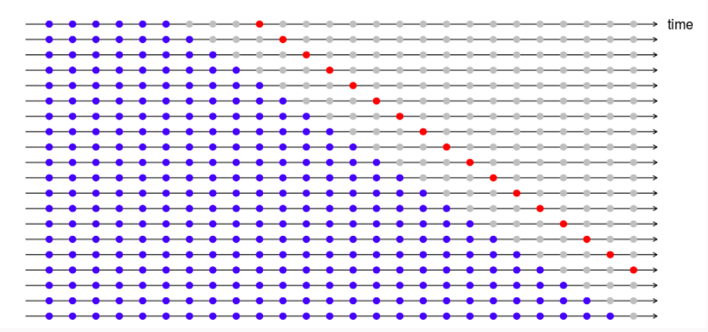
Evaluation pipeline setup
Two approaches:
Separate dataset manually (0.64：0.16： 0.2)
Separate dataset using time series cross-validation
Differences and decision:
What’s the difference between the two approaches and which one is better for this project

Slide 5
Features selection
Method：
Lasso regression
Extract numeric features in dataset
log transform the skewed numeric data
handle NA values: using column means to replace NA values
normalize and standardize data (Robust Scaler, Standard Scaler)

Slide 6
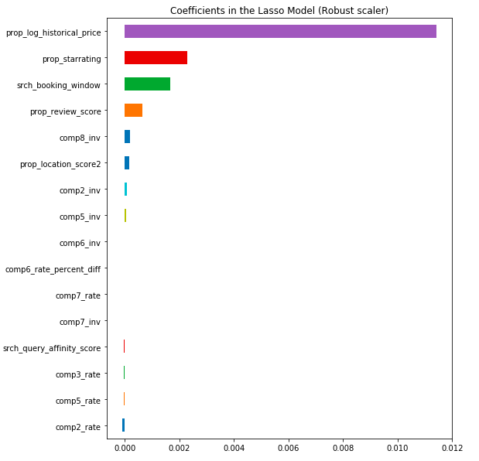
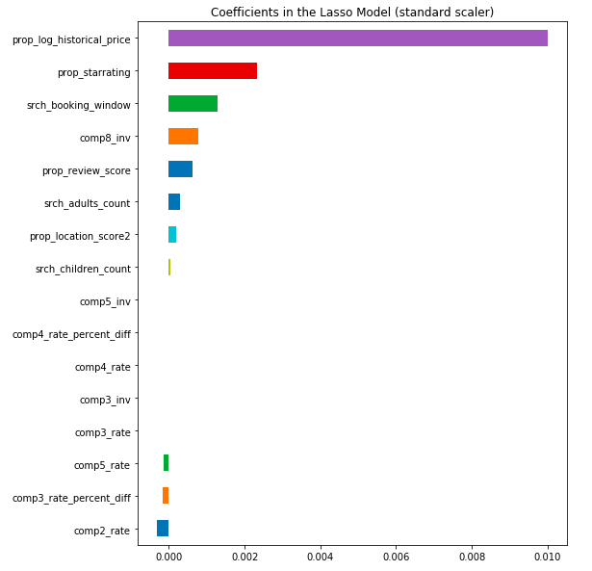

Slide 7
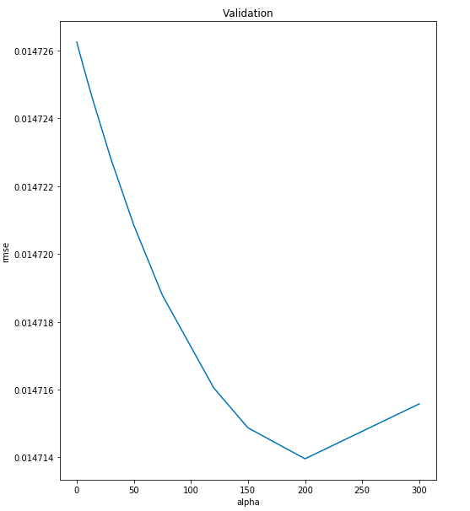
Baseline and evaluation
Ridge cross validation plot:
Lasso regression:
Training accuracy: 0.435
Ridge regression:
Ridge can get a minimum RMSE = 0.0147
Training accuracy: 0.437

Slide 8
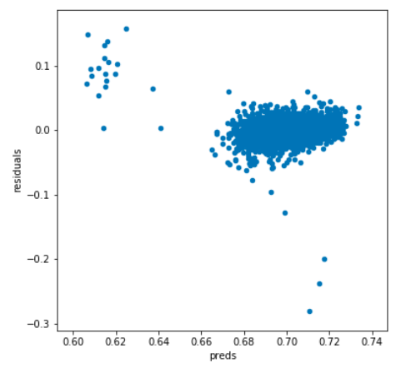
Residual plot：

Slide 9
Next steps
Baseline: KNN
Evaluation Pipeline setup: Choose time series cross validation approach to split training, validation, test data & compare performance with manually separation method

